Slide 1
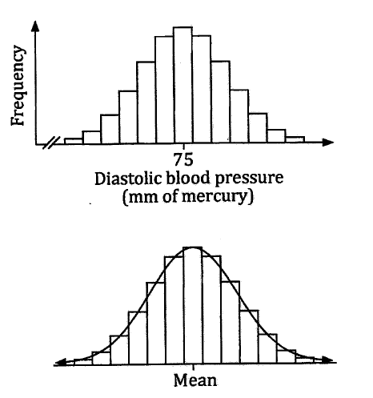
Normal Distribution
The diastolic blood pressure of a large number of adults was measured and the mean value was found to be 75mm of mercury (the unit blood pressure is measured in).
The data, presented as a histogram, has a fairly symmetrical shape.
Many values are close to the mean and the number of values decreases as we move either direction from the mean.
Fitting a smooth curve to the midpoints of the columns gives us a bell shaped curve.
If we collect lots of data about something that occurs naturally and draw a histogram of the results, it would often follow this bell shaped curve.
The heights of adult females
The weights of pet cats
The resting heart rates of 30 year olds
The foot lengths of adult males etc.

Slide 2
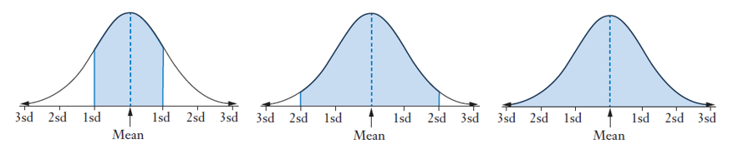
Normal Distribution
Data that follows this bell shape curve is said to be normally distributed.
In normal distributions, around two-thirds of the data values lie within 1 standard deviation of the mean (either 1 above or 1 below), around 95% lies within 1 or 2 standard deviations of the mean and nearly all lie within 3 standard deviations of the mean.
This is the 68%, 95%, 99.7% rule.
68.3% of data fits into the shaded area
95.4% of data fits into the shaded area
99.7% of data fits into the shaded area
We can use this information to begin to discuss probabilities.
If a data set is normally distributed, the probability of a person being within:
One standard deviation of the mean is 0.683 or 683/1000
Two standard deviations of the mean is 0.954 or 954/1000
Three standard deviations of the mean is 0.997 or 997/1000
The probability of someone being more than 3 standard deviations from the mean is therefore 0.003 or 3 in 1000 people!

Slide 3
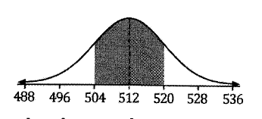
Example 2
A box of cereal has ‘contains 500g of cereal’ printed on it.
The actual weight of cereal contained in the boxes is normally distributed with a mean of 512g and a standard deviation of 8g.
Determine the probability that a randomly chosen box of this cereal contains between 504g and 520g.
If the mean is 512g and the standard deviation is 8g,
504g is exactly one standard deviation below the mean
520g is exactly one standard deviation above the mean.
For normally distributed data, the chance that a data point is within 1 standard deviation of the mean is 0.683 (using the 68%, 95%, 99.7% rule).
So the probability that the box of cereal weighs between 504g and 520g is 0.68 (to 2dp) or 68%.
We can in fact work out the probability that the box of cereal is within any of the sections in the normal distribution curve.

Slide 4
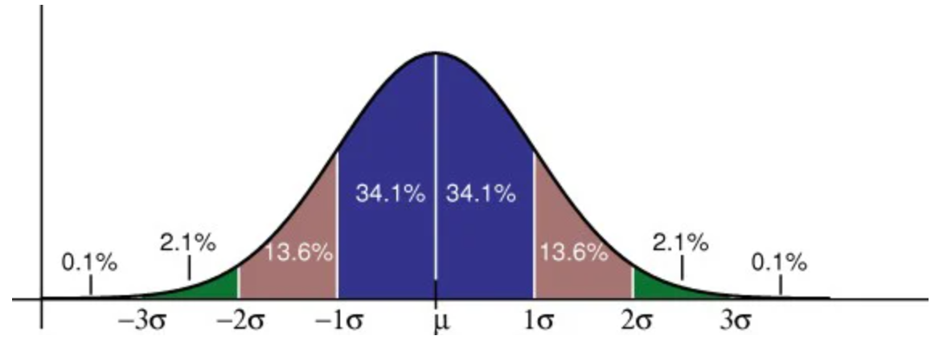
Example 2
A box of cereal has ‘contains 500g of cereal’ printed on it.
The actual weight of cereal contained in the boxes is normally distributed with a mean of 512g and a standard deviation of 8g.
488
496
504
512
520
528
536
What is the probability a box of cereal weighs:
Between 488g and 536g (3 standard deviations of the mean so 0.997 or 99.7%)
Between 496g and 512g (13.6 + 34.1 = 47.7%)
Between 520g and 536g (13.6 + 2.1 = 15.7%)
Between 496g and 520g (13.6 + 34.1 + 34.1 = 81.8%)
Less than 500g????
Why can’t we do this using the same method?

Slide 5
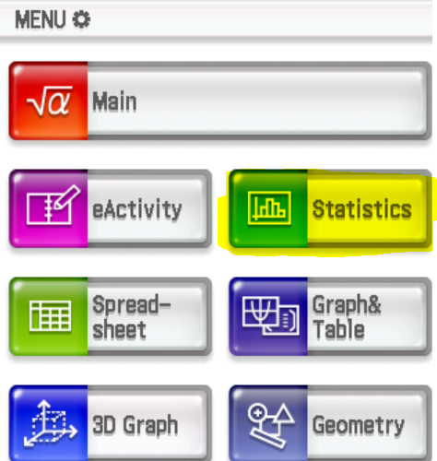
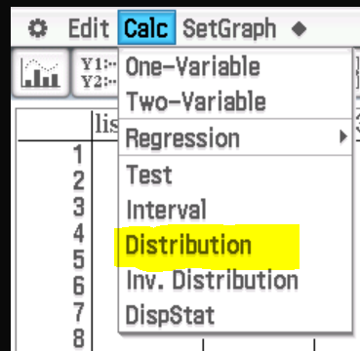
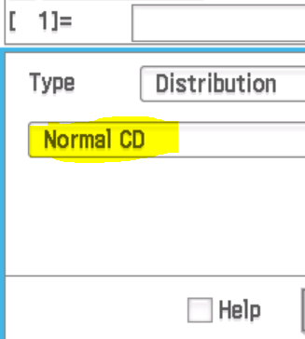
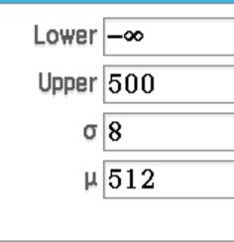
Example 3 – using a Class Pad
A box of cereal has ‘contains 500g of cereal’ printed on it.
The actual weight of cereal contained in the boxes is normally distributed with a mean of 512g and a standard deviation of 8g.
Determine the probability that a randomly chosen box of this cereal contains less than 500g.
In a sample of 100 boxes, about how many would contain less than 500g?
We need to find the probability a box contains less than 500g $P\left(X<500\right).$
We can use our Class Pads to give us this probability.
Lowest amount
Highest amount
Standard deviation
Mean

Slide 6
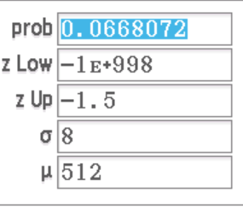
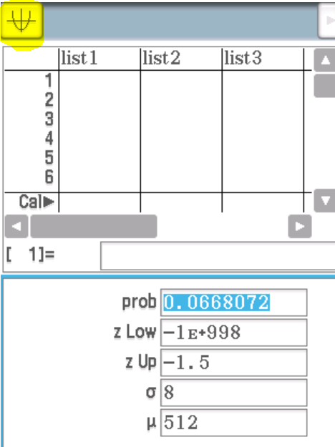
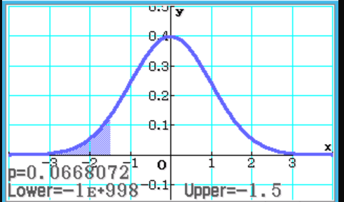
Example 3 – using a Class Pad
A box of cereal has ‘contains 500g of cereal’ printed on it.
The actual weight of cereal contained in the boxes is normally distributed with a mean of 512g and a standard deviation of 8g.
Determine the probability that a randomly chosen box of this cereal contains less than 500g.
In a sample of 100 boxes, about how many would contain less than 500g?
The probability that a box contains less than 500g is about 0.0668 or 0.07 (to 2dp).
In a sample of 100 boxes, we would expect about $0.0668 ×100=6.68$
or 7 boxes to contain less than 500g.

Slide 7

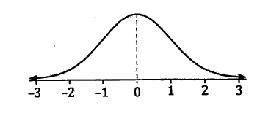
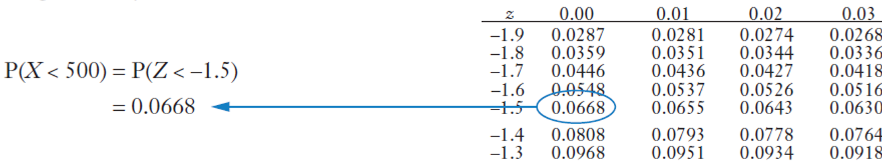
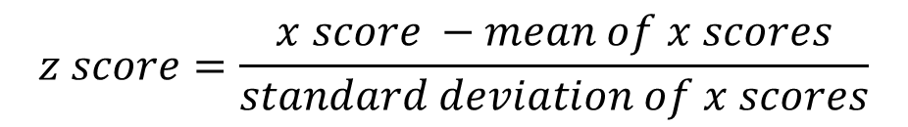
In the land before time - using a book of tables
Before Class Pads were routinely used, the probabilities associated with normal distribution were determined using books of statistical tables. (This is how Miss Levitt learnt it in high school!)
The statistical tables give probabilities for the standard normal distribution, where the mean is 0 and the standard deviation is 1.
In order to use the standard normal distribution, you had to standardise all your scores (x) first, using the formula from Exercise 13A, to create a standard score (z).
$$z score=\frac{x score −mean of x scores}{standard deviation of x scores}$$
$z score=\frac{500 −512}{8}=−1.5$ (500g is 1.5 standard deviations below the mean)

Slide 8
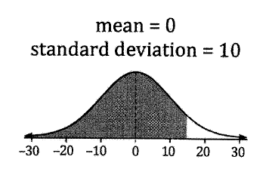
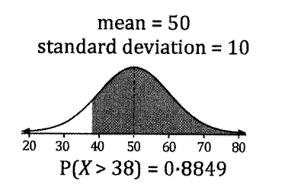
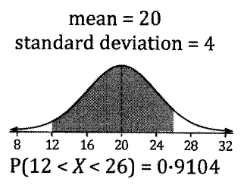
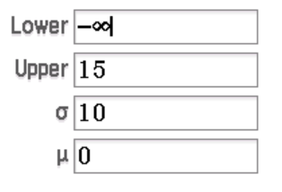
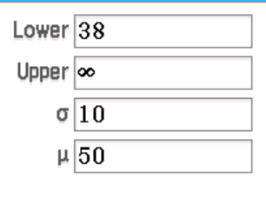
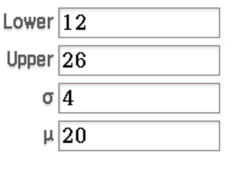



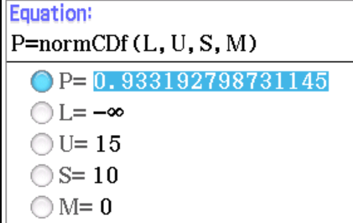
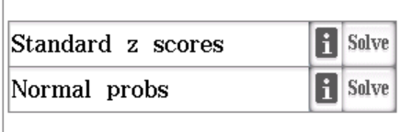
More Probability Calculations
Now do Exercise 13B
P(X<15) = 0.933
We can also use the normal distribution formulas in our E-activity to do this.

